Slide 1
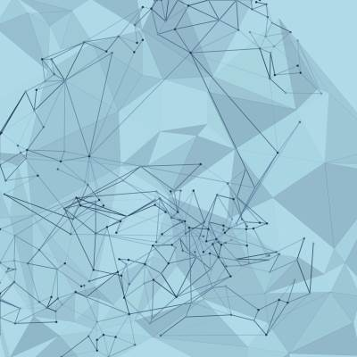
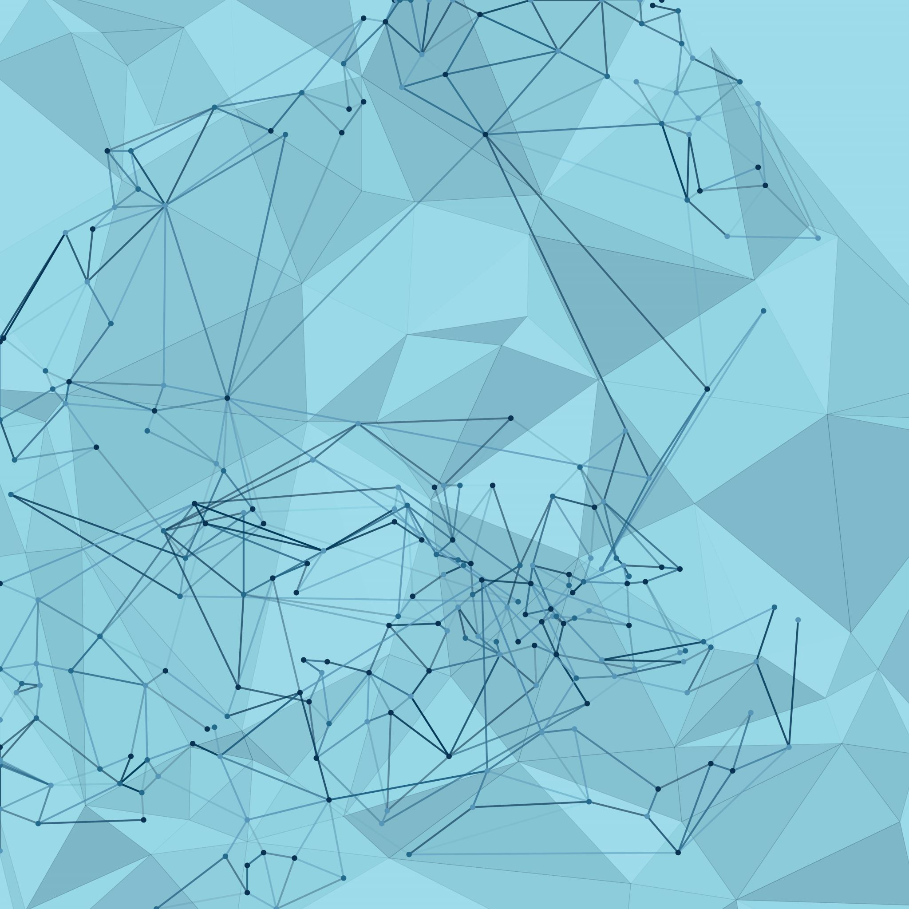
the SolarWinds exploits
using the Cyber Kill Chain Framework

Slide 2
SolarWinds Breach Overview
The attackers exploited the trust placed in software updates, turning a routine process into a vector for compromise. The term "Advanced Persistent Threat" truly captures the nature of this attack, emphasizing its persistence and sophistication.
On December 13, 2020, FireEye announced the discovery of a highly sophisticated cyber intrusion that leveraged a commercial software application made by SolarWinds. It was determined that the advanced persistent threat (APT) actors infiltrated the supply chain of SolarWinds, inserting a backdoor into the product. As customers downloaded the Trojan Horse installation packages from SolarWinds, attackers were able to access the systems running the SolarWinds product(s).
This cyber-attack is exceptionally complex and continues to evolve. The attackers randomized parts of their actions making traditional identification steps such as scanning for known indicators of compromise (IOC) of limited value. Affected organizations should prepare for a complex and difficult remediation from this attack.

Slide 3
Mitigation Strategies: Cyber Kill Chain Approach
Reconnaissance: Implement access controls, and also Isolate critical systems to limit the potential impact of an attack.
Weaponization & Delivery: Employ advanced email filtering solutions to detect and block malicious attachments and links, and regularly update software to patch known vulnerabilities, reducing the risk of exploitation.
Exploitation and Installation: Conduct regular vulnerability assessments and promptly patch or mitigate identified vulnerabilities, and utilize advanced endpoint protection to detect and block malicious code.
Command and Control & Actions on Objectives: Continuously monitor network traffic for unusual patterns and connections, and encrypt sensitive data at rest and in transit to protect it from unauthorized access.

Slide 4
Recommended Tools for Mitigation
Reconnaissance: Nmap, Shodan, Wireshark.
Weaponization and Delivery: Metasploit, Wireshark, Phish Me, Spam Assassin.
Exploitation and Installation: Nmap, SQLMap, Wireshark, Tripwire, Burpsuite.
Command and Control & Actions on Objectives: Snort, VeraCrypt, SIEM systems

Slide 5
SUMMARY
The SolarWinds breach underscored the vulnerability of software supply chains and the potential for widespread consequences. It prompted a reevaluation of cybersecurity measures, especially in the context of third-party software providers.
In response to the breach, affected organizations took steps to remove the compromised software, enhance cybersecurity measures, and investigate the extent of the compromise. The incident prompted discussions about improving supply chain security and resilience.
The SolarWinds breach highlighted the need for organizations to implement robust cybersecurity practices, conduct thorough supply chain risk assessments, and enhance detection and response capabilities to address sophisticated cyber threats effectively.

